Slide 1
Protocol Security
Chapter 3

Slide 2
Learning Outcomes
Identify the various types of attacks on a switch and implement secure switch configuration by using mitigation techniques.

Slide 3
Protecting the Layer 2 and 3 Switch
The switch plays an important role in any network and it is vital to secure them against network attacks. Most of these attacks occur internal to the network (i.e. attacker has physical access to the network/ LAN point in order to launch these attacks)
Types of Attacks:
MAC address spoofing
MAC address table overflows
LAN storms

Slide 4
Types of Attacks:
MAC address spoofing
MAC address table overflows
LAN storms

Slide 5
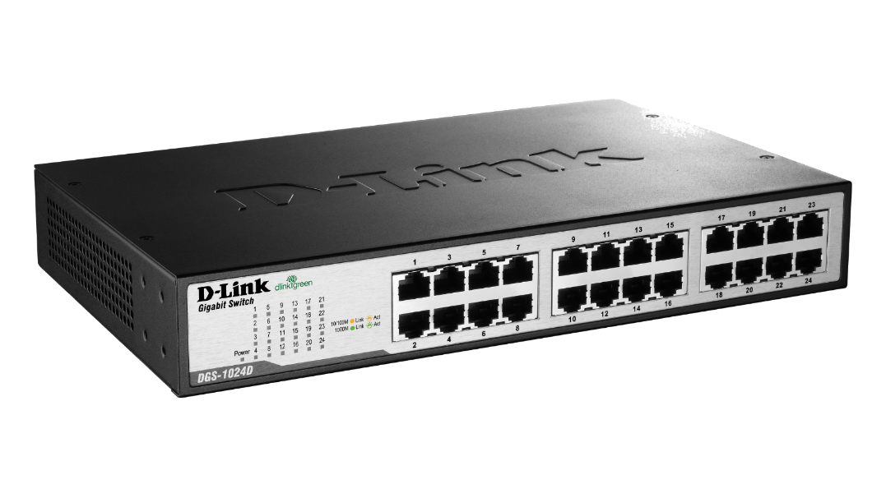

How does MAC address table in switch work?
FA0/1
FA0/2
PCA with MAC=1111:1111:1111
MAC Address | Port Number
1111:1111:1111 | FA0/1
2222:2222:2222 | FA0/2
Frame
If the source MAC entry doesn’t exist, the switch populates its table with the source MAC addr of an incoming frame and the port on which it came from.
If destination MAC entry doesn’t exist, the switch will broadcast the frame on all ports except the one it received the frame on.
PCB with MAC=2222:2222:2222
Notes:
https://www.youtube.com/watch?v=wKtA31whDSQ
https://www.youtube.com/watch?v=WqjpBn-0oI4

Slide 6
Packet Tracer Example

Slide 7
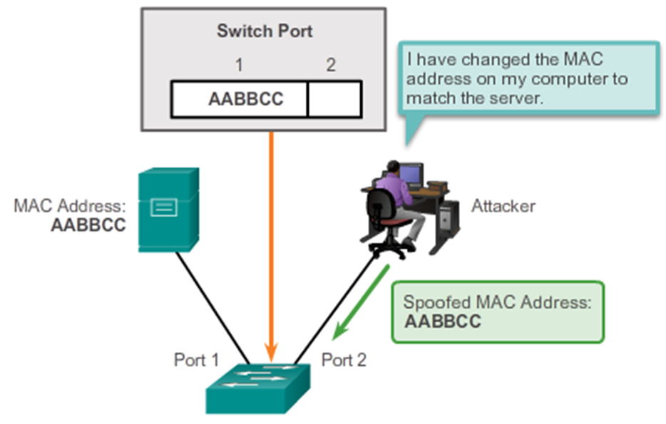
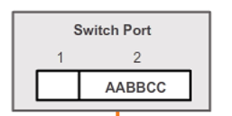
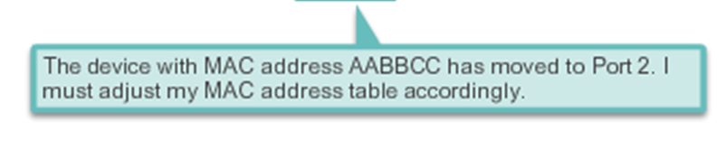
MAC Address Spoofing
Attacker changes his computer’s Ethernet adapter MAC address to the victim’s address. This is called spoofing.
When the switch receives packets with source address of the victim on another port, it updates its MAC table.
Now any packet destined to the victim can now be seen by the attacker.
This is provided the victim doesn’t send any packets to the switch during the attack.
http://itsecurity.telelink.com/mac-address-spoofing/

Slide 8
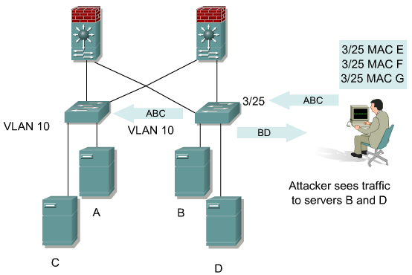
MAC Address Table Overflow Attack
The attacker will send many spoofed source MAC addresses to the switch to flood it’s MAC address table or CAM.
If the table is full with bogus entries, traffic without an entry on the CAM will be broadcast to all ports.
The attacker can now sniff packets destined for the servers
CAM- Content Addressable Memory table

Slide 9
Mitigation Techniques for MAC attacks
Both MAC spoofing and MAC address table overflow attacks can be mitigated by configuring port security on the switch.
Port security is configurations done on a switch port to restrict the number of secure MAC address connections on a port. If the condition is violated, certain actions will be taken.
This will prevent hackers from plugging in their “unregistered” MAC address devices into the switch port to cause havoc.

Slide 10
Port Security
There are 2 ways to configure port security:
  Statically specify the MAC addresses on a particular switch port. However this is a very tedious job if the company has many devices.
  Allow the switch to dynamically learn a fixed number of MAC addresses for a switch port. This is an administratively scalable solution.
When a MAC address differs from the list of configured or learnt secure addresses, the port either:
  Shuts down until it is administratively enabled (default mode).
  Drops incoming frames from the insecure host and sends an log record to the Syslog server (restrict option).
  Drops incoming frames from the insecure host only. No traps sent (protect option).
The port behaviour depends on how it is configured to respond to a security violation. Shutdown is the recommended security violation. Restrict/protect modes will revert back to normal operational modes if the violation is no longer there.

Slide 11
Configuring Port Security
Switch(config-if)# switchport mode access
Change the switch interface port to access mode.
Switch(config-if)# switchport port-security
Enable port security on the interface.
Switch(config-if)# switchport port-security maximum 2
Set the maximum number of secure MAC addresses allowed on the interface. Range is 1 to 132 but the default is 1.
Switch(config-if)# show port-security
To verify port security configurations

Slide 12
Configuring Port Security cont…
Switch(config-if)# switchport port-security mac-address 2222:2222:2222
Statically entering a secure MAC address in the MAC table to be associated with this Interface.
Switch(config-if)# switchport port-security mac-address sticky
Switch will dynamically learn the MAC address of the connected device when the device sends a frame.
Switch(config-if)# switchport port-security violation shutdown
If unregistered MAC address is detected on a switch port, switch will shutdown the port. You can also configure the switch to simple drop incoming packets until unregistered device is taken away.(restrict/protect).

Slide 13
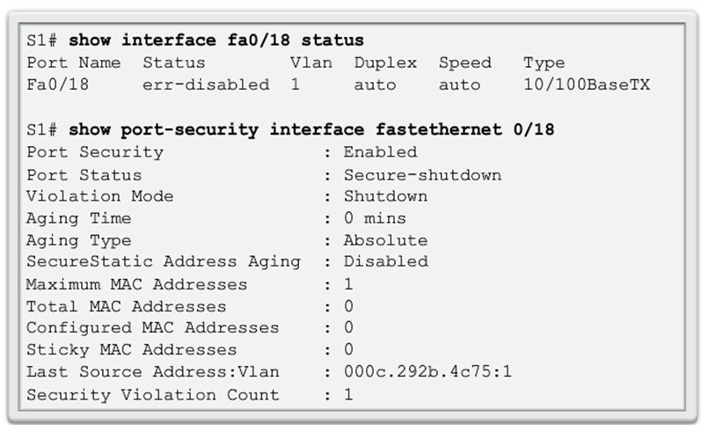
How to revert port status?
You have a port which is shutdown because of a port security violation. When you check the status of the port, it says err-disabled (i.e. Shutdown)
How do you bring the port back up again assuming the threat has been resolved?
What if the port were configured
with Restrict/Protect?

Slide 14
Types of Attacks:
MAC address spoofing
MAC address table overflows
LAN storms

Slide 15
How do LAN Storms Occur?
A LAN storm occurs when packets flood the LAN, creating excessive traffic and degrading network performance.
Possible causes:
  No STP loop prevention configured on switches
  Misconfigurations or equipment plugged in wrongly
  Users issuing a DoS attack

Slide 16
Mitigation Techniques for B.Storms
LAN storm attacks can be mitigated by using storm control to monitor predefined suppression-level thresholds. Both a rising threshold and a falling threshold can be set.
Storm control uses one of these methods to measure traffic activity:
  Bandwidth as a percentage (%) of the total available bandwidth of the port.
  Traffic rate in packets/sec or bits/sec at which packets are received.
With each method, the port blocks traffic when the predefined rising threshold is reached.
  The port remains blocked until the traffic rate drops below the falling threshold if one is specified, and then resumes normal forwarding.

Slide 17
Configuring Storm Control
Switch(config-if)#storm-control broadcast level 75
You can configure to control broadcast, multicast or unicast traffic. The level specifies the maximum traffic allowed on that link, which in this case is 75% of the max capacity.
Switch(config-if)#storm-control action shutdown
If the threshold set above is exceeded, then port will shutdown. You can also set it to “trap”, which send SNMP log messages to server when storm occurs. (non-PT command)

Slide 18
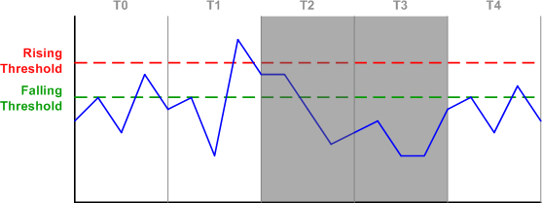
Configuring Storm Control cont…
Switch(config-if)#storm-control multicast level pps 2k 1k
Enables multicast storm protection. If link’s packets per sec goes beyond 2000 pps (upper threshold) traffic will be blocked. It will be blocked until traffic is lower than lower threshold. (Non-PT command)
Switch(config-if)#show storm-control
http://packetlife.net/blog/2008/nov/27/storm-control/
SW1# show storm-control
Interface Filter State Upper Lower Current
--------- ------------- ---------- --------- ---------
Gi0/1 Forwarding 20 pps 10 pps 5 pps
Gi0/2 Forwarding 50.00% 40.00% 0.00%
<output omitted>
Notes:
In interval T0, inbound traffic is accepted as its rate never exceeds the rising threshold. In T1, the rising threshold is exceeded, and the switch makes a note to block incoming traffic for the next interval. In T2, traffic is blocked, but the switch continues to monitor the incoming rate. Although the rate has fallen below the rising threshold, it still exceeds the falling threshold, so the switch will continue to block traffic for the next interval.
During T3, traffic stays below the falling interval, so the switch removes the blocking for T4. Although traffic in T4 exceeds the falling threshold again, traffic will not be blocked for the next interval as the rising threshold hasn't been exceeded.

Slide 19
THE END

